Slide 1
MIS 7720 #5 Frameworks and Platforms

Slide 2
Popular frameworks
Most used languages: Python, R, C++ (backend optimizations)
Frameworks & Platforms:
TensorFlow, Keras, Theano, PyTorch, scikit-learn, Caffe2,…
Microsoft Cognitive Toolkit (CNTK), Accord.NET, ML.NET,…
Mahout, Spark ML (Apache) – part of Hadoop ecosystem
Using cloud services:
Google, Amazon AWS (SageMaker, …), Microsoft (Azure, …), IBM (Watson, …)
Notes:
DL sw comparison
https://en.wikipedia.org/wiki/Comparison_of_deep_learning_software
DL frameworks compared
https://www.youtube.com/watch?v=MDP9FfsNx60

Slide 3
R and R Studio
R: programming language for statistical computing, graphics, data mining, ML, …
Runs on UNIX, Windows, MacOS
Download:
https://cran.r-project.org/mirrors.html
https://cran.cnr.berkeley.edu/
Microsoft R Open enhanced R distribution
https://mran.microsoft.com/
R Studio: free and open source IDE for R
Various libraries for all sorts of analysis

Slide 4


Scikit-learn
Open source ML in Python framework (BSD license)
Includes all classic ML/DM algorithms
Supervised & unsupervised
Preprocessing, Classification, Regression, Clustering, Model Selection,…
Easy to use
recent Neural Network support
No GPU support
Scikit-image: is a collection of algorithms for image processing.
Notes:
All algorithms are now available in TensorFlow

Slide 5




NumPy and SciPy ecosystem
NumPy: fundamental package for numerical computation.
numerical array and matrix types and basic operations on them
useful linear algebra, Fourier transform, and random number capabilities
Some other main packages in the SciPy ecosystem
Matplotlib: Comprehensive 2D plotting, basic 3D
Pandas: high-performance, easy to use data structures
Jupyter notebooks: IPhython functionality (and other languages) in your web browser
SymPy: symbolic mathematics
…
Notes:
See https://scipy.org/

Slide 6
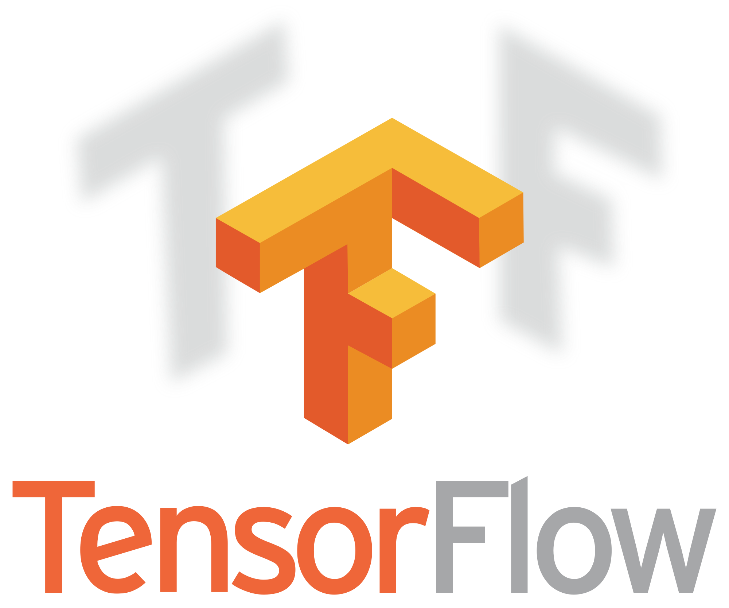
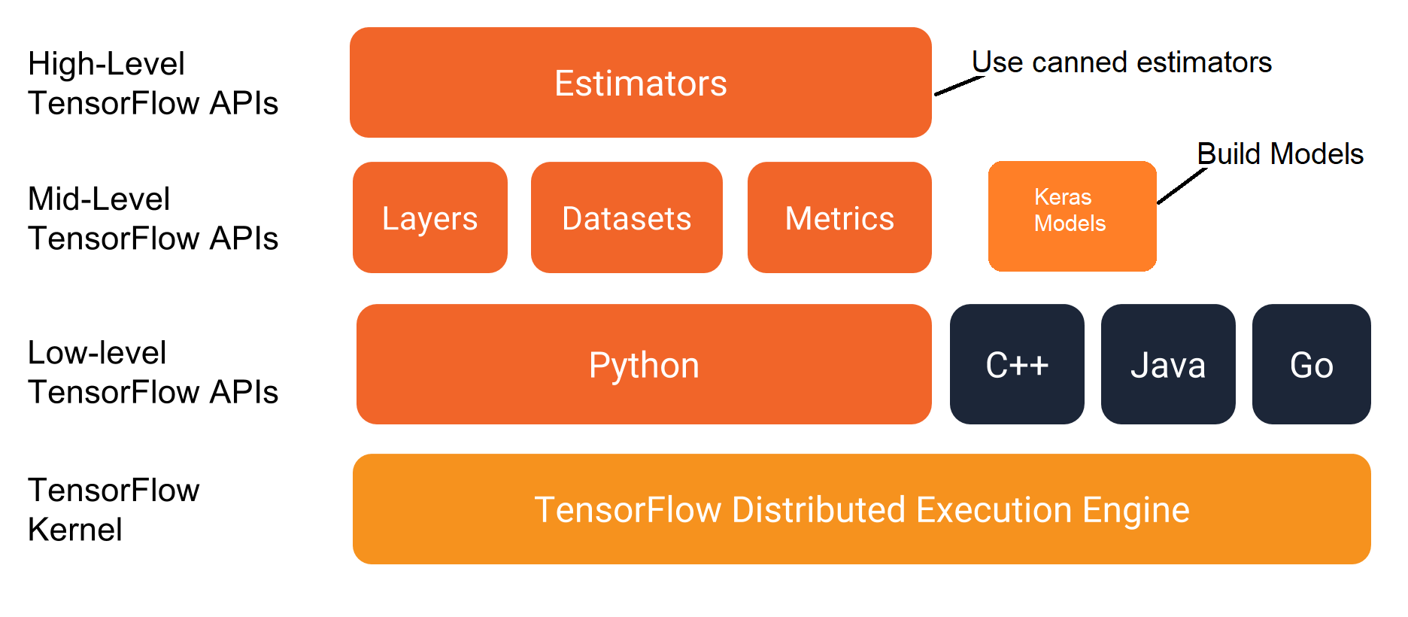
TensorFlow
Open source ML framework from Google
Fast (backend in C/C++)
Data flow graphs
Nodes are functions/operators
Edges are input or data (tensors)
Large community
Powerful
Supports multiple languages
Need to know ML
Low-level APIs
Higher-level since TF2
Steep learning curve
Easier since TF2
Notes:
TensorFlow2 released Oct 2019 TF Learn (Keras optimized for TF)
TensorBoard (great visualization tool for training models)

Slide 7

Keras
Open source python library for Deep Learning
Runs on top of Tensorflow, CNTK, or Theano backends
Easy to use high-level APIs
Neural Network Applications: CNN, RNN & LSTM
Fast experimentation, Modular & Extensible
Object-oriented design
Broad community
General purpose but could lack on performance
Define Network
Fit/Train Network
Evaluate Network
Compile Network
Make Predictions
Notes:
Note: TF Learn (Keras optimized for TensorFlow) is similarly high-level with TF power

Slide 8

PyTorch
Open source DL platform started by Facebook
https://pytorch.org
Primarily a Python package
Intuitive Python-like code
Tensor computations
GPU/CUDA support

Slide 9
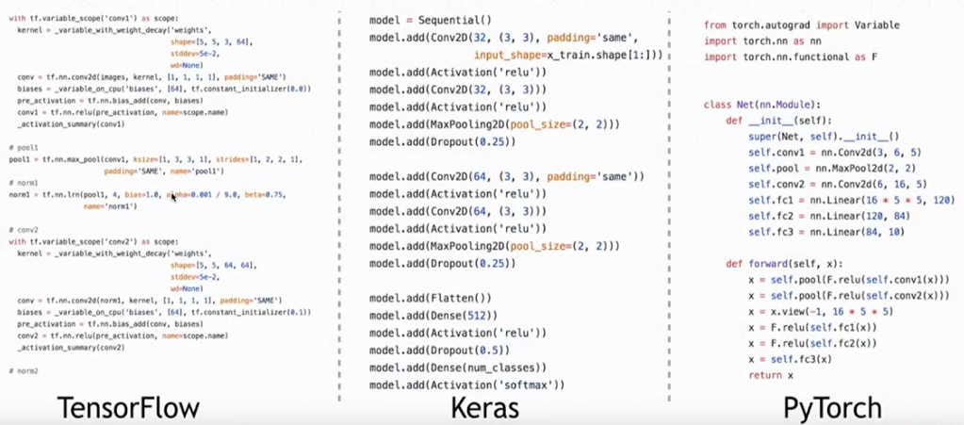
TensorFlow, Keras, PyTorch code comparison for a simple NN
Notes:
More comparisons…
https://cv-tricks.com/deep-learning-2/tensorflow-or-pytorch/
https://en.wikipedia.org/wiki/Comparison_of_deep_learning_software

Slide 10

Theano
Python library that allows you to define, optimize, and evaluate mathematical expressions efficiently
Open-source symbolic tensor manipulation framework developed by LISA Lab at Université de Montréal
Official support ceased since Sep 2017 (“due to competing offerings by strong industrial players”)

Slide 11
Microsoft Cognitive Toolkit (CNTK)
Free, open source Deep Learning framework by Microsoft
Like some other platforms, includes many ML, DL models
see https://www.microsoft.com/en-us/cognitive-toolkit/features/model-gallery/
Less popular (smaller community)
GPU support
C#, C++, Python

Slide 12
Free Data Sets
https://www.springboard.com/blog/free-public-data-sets-data-science-project/
https://www.kaggle.com/datasets
https://archive.ics.uci.edu/ml/index.php
https://grouplens.org/datasets/movielens/
…
Search for datasets on Google
https://datasetsearch.research.google.com/

